Slide 1
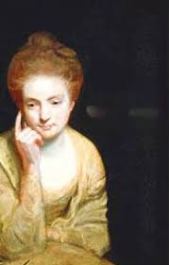
Mary Astell “The First English Feminist”
Gentrain 410
Stephanie Spoto
Monterey Peninsula College

Slide 2
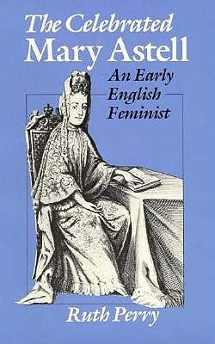
Mary Astell (1666-1731)
English protofeminist writer, philosopher, and rhetorician (someone who studies the art of persuasion and persuasive writing).
Advocated for women’s equal education → this earned her the title of “the first English feminist”
Ruth Perry: "as a woman she had little or no business in the world of commerce, politics, or law. She was born, she died; she owned a small house for some years; she kept a bank account; she helped to open a charity school in Chelsea: these facts the public listings can supply.“
Few records remain. Only four of her letters were saved (these because they were written to important male contemporaries)
If she had not written to wealthy aristocrats whose records remained relatively intact, there would be very little of her life known to us.

Slide 3
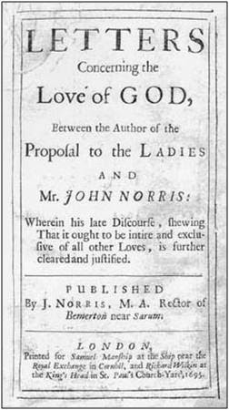
List of published works
A Serious Proposal to the Ladies, Parts I and II. Wherein a Method is offer’d for the Improvement of their Minds (1694, 1697)
Letters Concerning the Love of God Between the Author of the Proposal to the Ladies and Mr. John Norris: Wherein his late Discourse, shewing That it ought to be intire and exclusive of all other Loves, is further cleared and justified (1695)
Some Reflections upon Marriage, Occasion’d by the Duke and Duchess of Mazarine’s Case; which is also considered (1700)
The Christian Religion, As Profess’d by a Daughter Of the Church of England (1705)

Slide 4
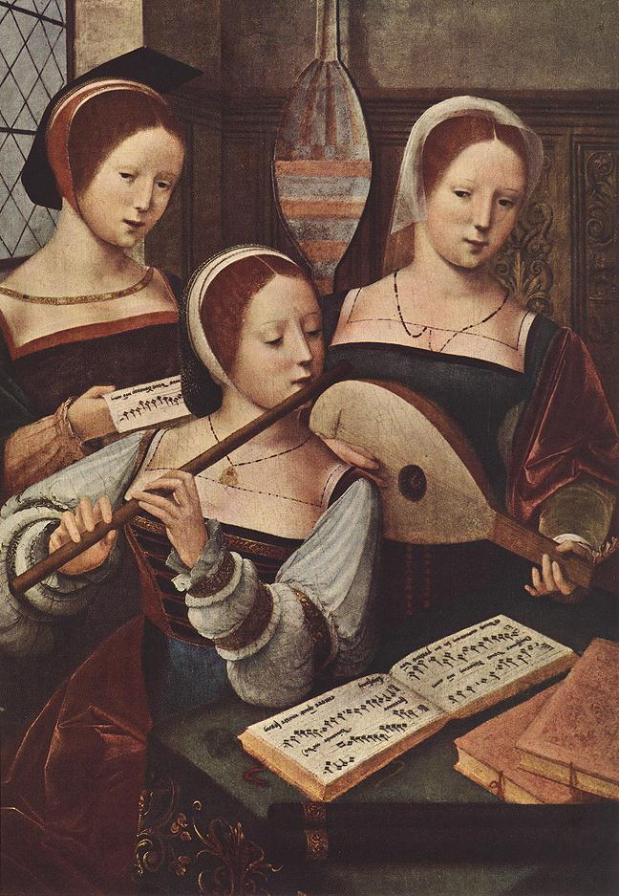
Education and salvation
Works published anonymously → part of the convention of the time
Praised for their style and argument
A Serious Proposal (Parts I and II) argue a plan to create a new type of educational and religious institution for women → women should have more career options besides mother and nun
Education important→ otherwise women concerned with only beauty and vanity → lack of education can account for their inferiority to men (not natural)
Desired that women have the same chances and opportunities as men to spend all eternity with God in heaven → needed education to do this → helps women understand their experiences.
Education style proposed similar to a nunnery → this would allow women to live in a protected environment without the influence of men or a patriarchal society

Slide 5
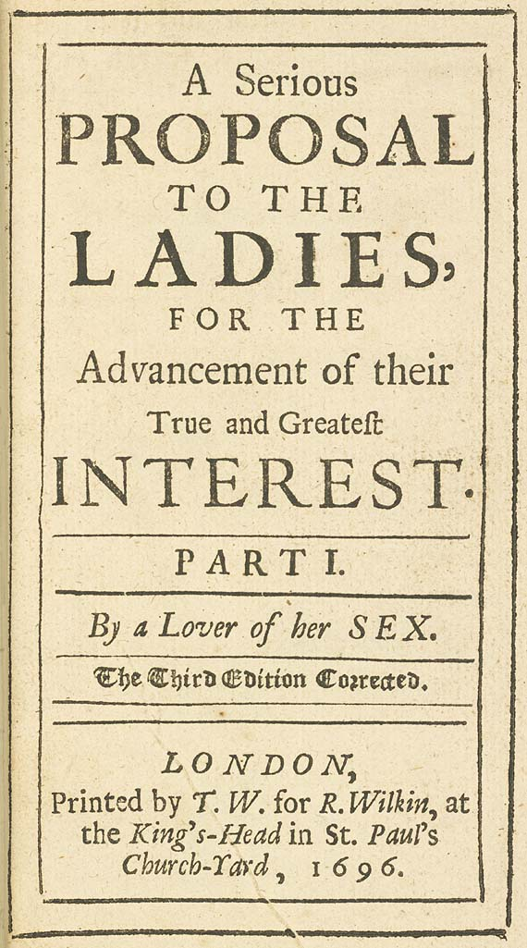
Rhetoric and women’s education
The two parts of A Serious Proposal to the Ladies were published within a few years of each other
The second part details her vision of education for courtly ladies
Breaks away from common rhetorical style of the time which mimics an orator speaking before an audience
Offers instead a conversation about correct behavior → a style of teaching “neighbours”
Her only cited source is the Port-Royal Logic: a French work on logic with strong influences in Cartesian dualism and metaphysics
The rest of the work relies on classical (ancient Greek and Roman) theories of rhetoric → presents them through her own original ideas
Argues that the art of rhetoric does not require a masculine education → concentrates on the ways that women can develop the core skills from natural logic

Slide 6
Themes Friendship
Contributes to ideas of female friendship: centers on the idea of forming relations and alliances based on political requirements
Aristotelianist or Anti-Aristotelianist?
Jacqueline Broad: Astell’s bond of friendship is Aristotelian → alliances formed for virtuous reciprocity
Nancy Kendrick: Astell’s bonds of friendship are actually anti-Aristotelianist → though Astell incorporated Aristotle’s theory of friendship as moral virtue, Kendrick claims that Astell’s friendship is "virtuous friends as those who love one another for who they essentially are" and not just for reciprocity's sake.
Astell argues that true friendship arises from the Divine Nature of God → can become spiritual friendship
Astell saw this love as possibly extending towards one’s enemies → divine love embraces all
Astell considered herself a self-reliant, modern woman → on a definite mission to rescue her sex from the patriarchal oppression

Slide 7
Themes Education for women
Astell herself never received a formal education → though she did receive an informal education from her uncle Ralph Astell (affiliated with the Cambridge Platonists)
Astell: women should be education in spiritual environment with only other women
World is corrupt because under solely male dominance and influence → women’s education should be free from that influence
Wanted to create a school for women, but this never happened in her lifetime.
Women should get education equal to that of men → shouldn’t have to marry
However, if they do marry, they must be subject to the will of their husbands

Slide 8
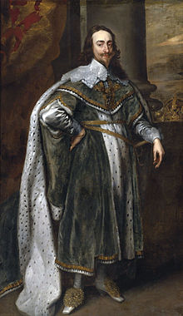
Themes Religion and Politics
Critiques John Lock’s An Essay Concerning Human Understanding and The Reasonableness of Christianity → claims that Locke’s work is deist or Socinian (non-Trinitarian)
Also attacks his skepticism regarding the truth of scripture and divinity of Christ → objects to Locke’s claim that Christ was merely “an extraordinary person” and that the beliefs of Christianity and Islam are equal
In The Christian Religion, Astell is concerned with “Duty to God” and “Duty to our Neighbour” → all humans are “brethren” and it is only sin and pride which leads us to see others as “creatures of a different species”
Interestingly, this beliefs co-exists with beliefs of the hierarchical distinctions: God’s works 'do not necessarily possess the same degree of perfection.’
Conservative beliefs in divine authority: Monarchist who regarded Charles I → thought his successors William and Mary were ‘illegitimate’ rulers
Tory, conservative politics and English nationalism led her to the belief that “it is better some innocents should suffer than the majesty of government, and herein the divine authority should be violated.“

Slide 9
Astell and Descartes Difference and sameness
Regarding the idea of independent minds, Astell differs from Descartes
Descartes in Discourse of Method: all minds have the same ability to reason
Astell: God creates minds with differing abilities → these differences are intrinsic
Justification for view: God wants us to form communities/relationships with others → these relationships are possible only if minds have different capacities
Minds are made to meditate on and enjoy God → but each mind is limited and can only enjoy and contemplate a limited amount of his works → the creation of many minds means that there are many opportunities for contemplation
Rather than individual minds understanding all of creation, the community of human minds can, in their diverse ways, meditate on all of creation

Slide 10
Mind-Body Dualism Mind-Body Union
For Astell, it seems as though minds are sometimes separate from bodies, however she claims that all humans are mind-body unions.
But this connection is unintelligible to us: “We know and feel the Union between our Soul and Body, but who amongst us sees so clearly, as to find out with Certitude and Exactness, the secret ties which unite two such different Substances, or how they are able to act upon each other?”
This union is mysterious: we “know and feel” it, but we don’t ever have perfect knowledge of it in essence or causally (how one influences the other)
Christian Religion: There is a connection between our lack of knowledge regarding the union of mind-body and the relation between God and humans
“Again, tho’ I do not understand the Philosophy of the Union between the Divine and Human Nature; (neither do I comprehend the Vital Union between my Soul and Body, nor how and in what manner they are joyn’d, tho’ I am sure that so it is) …”

Slide 11
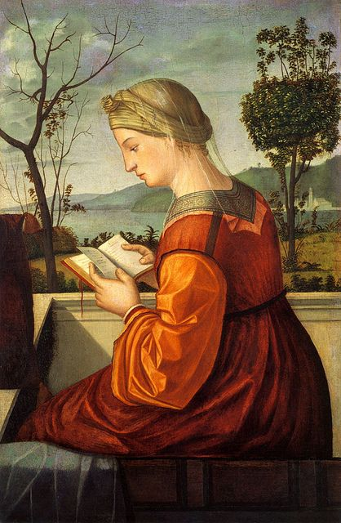
Dualism and women
If the mind is separate from the body, how do we think this might influence our understanding of women’s intellectual or spiritual capacities?

Slide 12
Mind-Body Dualism and views on women
Astell’s mind-body union and ideas of dualism: she argues against the common contemporary view about women → that they do not demonstrate the same intellectual abilities as men
Common view: women are inherently more closely united to bodies (more earthly, more fleshy, more prone to sin, and less able for contemplation)
Women’s inferiority is socially conditioned, not spiritually or biologically determined: what we understand as the uniformity of women’s abilities is not rooted in a feminine essence or biological nature → arises because of social practice
Therefore, these differences should be accounted for epistemologically, not metaphysically
It does not come from God, and is not hashed out in some relationship between the woman’s inferior mind and her body
Epistemology’s central questions: what do we know? How do we know it? For women, it is clear that what little is known by them is the result of the second question, for how can women know if they are not granted the access of knowing, i.e. an education?

Slide 13
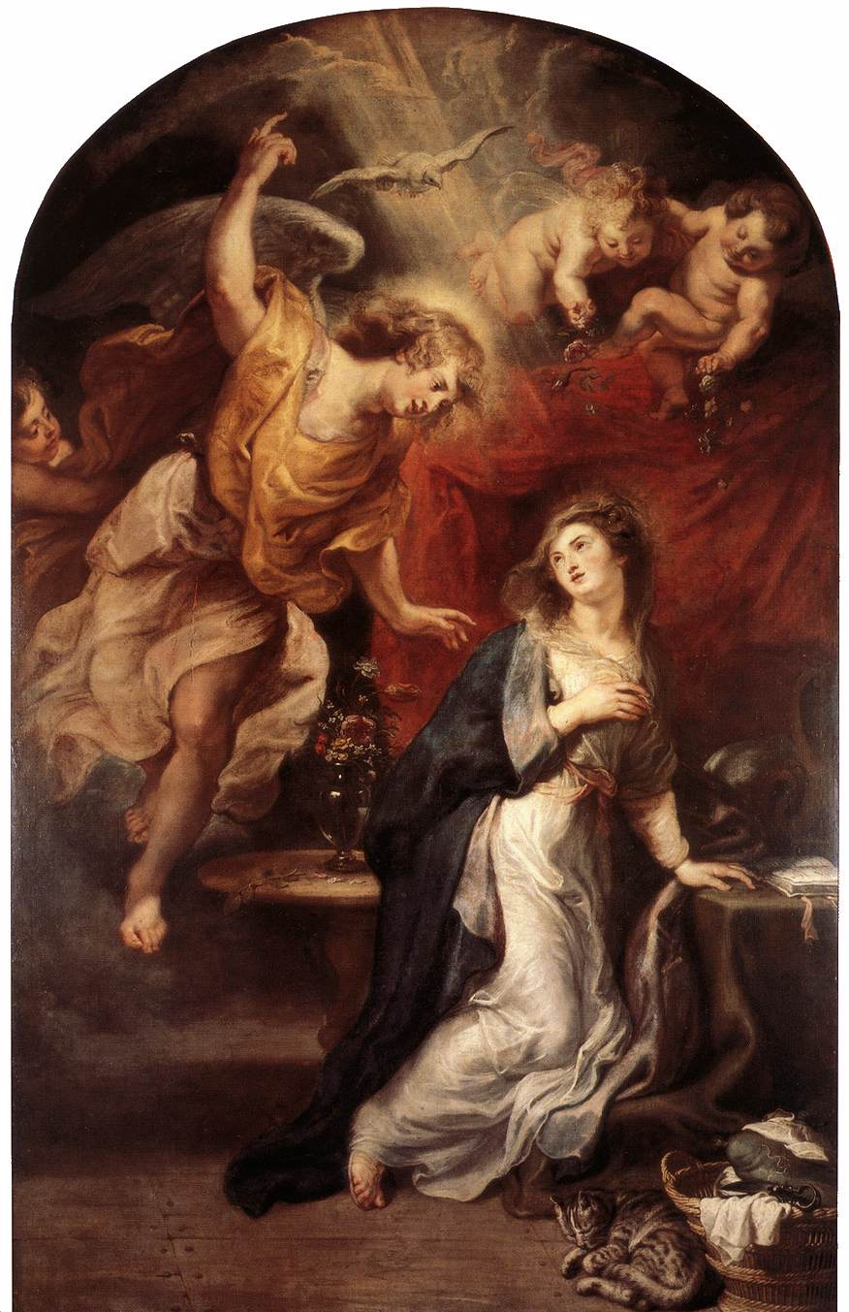
Union or distinct?
Though she argues for mind-body union, she also claims that they are “really distinct”
She has a social reason for arguing her account of mind-body union (that is, to argue against common accounts of women’s inferiority)
Also has social reason for arguments about mind-body distinction: if she can show that the mind (and not the body) is immortal, then she can demonstrate that God’s existence is important to them
We should not be caught up in the body for our answers and should instead focus on the mind and the spirit → for it is the spirit that is immortal and not the body

Slide 14
Legacy: remembered for her ability to argue and debate freely with both men and women
Also for her groundbreaking rhetorical methods in examining and situating woman’s place in society → engaged in philosophical debate rather than basing her positions in historical arguments
Descartes’s theory of mind-body dualism as distinct but joined allowed her to argue that women as well as men had the ability to reason and should not be oppressed by a male-dominated society
"If all Men are born Free, why are all Women born Slaves?"

